Slide 1
Reducing Waste and Improving Productivity at a Manufacturing Organization – Six Sigma
Presented By:
Antony Wilson
Natasha Basutkar
Shreyas Dhuru
Sushma Reddy Gurram
DMAIC

Slide 2
DEFINE
1
Define the Problem
DMAIC

Slide 3
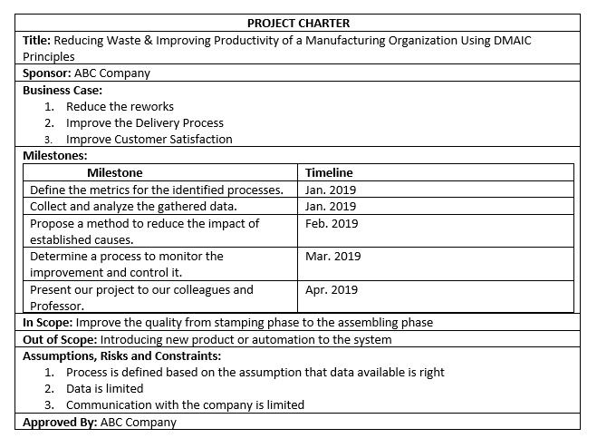
Project Charter
DMAIC

Slide 4
Business Case
Category | How to calculate | Amount
Quality | Total cost of all the operations for Rework | $ 336,000.00
Back Charge Cost | CSR cost tracking | $ 179,674.00
Total Cost $ 515,674.00
Budget Required= $ 800,000 (To form a new Quality team, labor cost, training, equipment cost etc.)
Defects in 2018= 4833
Defects in 2019= 904
Estimated Savings in 2019 = 515,674-((515,674/4833)*904)
= $ 419,218
Break even Point = (1*800,000)/419218
= 1.9 years
DMAIC

Slide 5
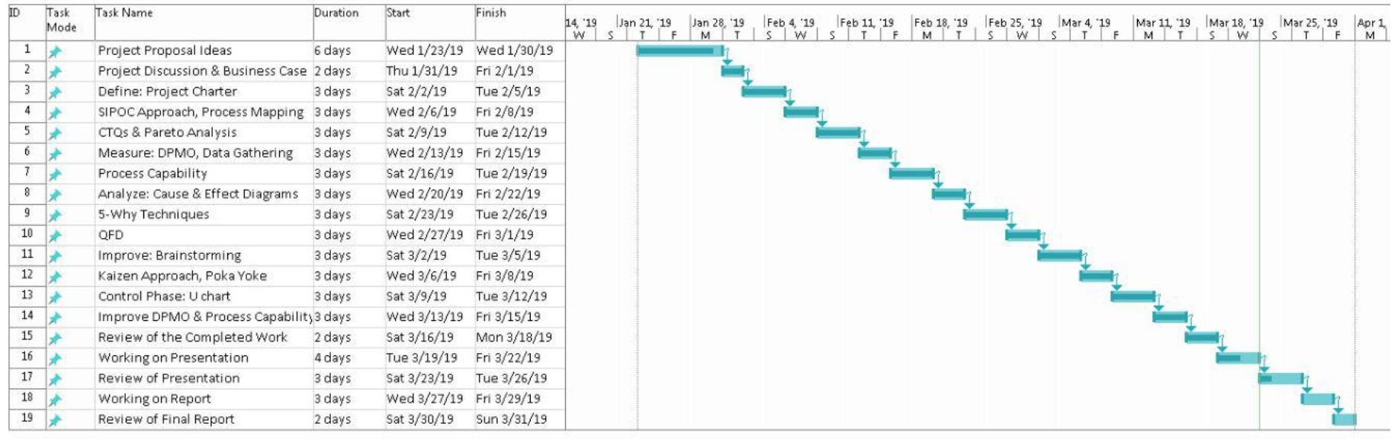
Gantt Chart
DMAIC

Slide 6
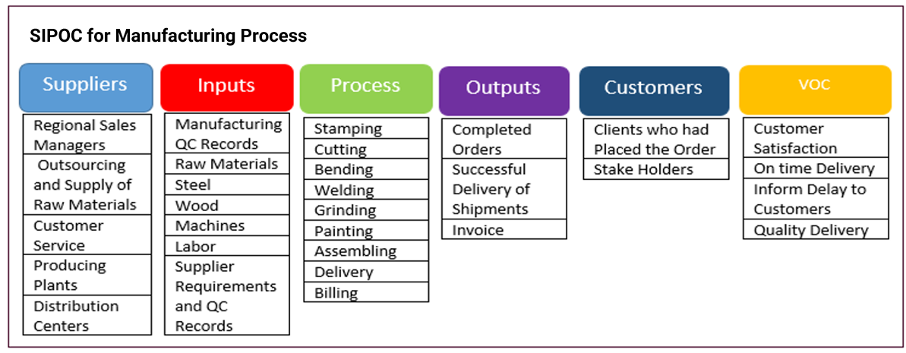
SIPOC
DMAIC

Slide 7
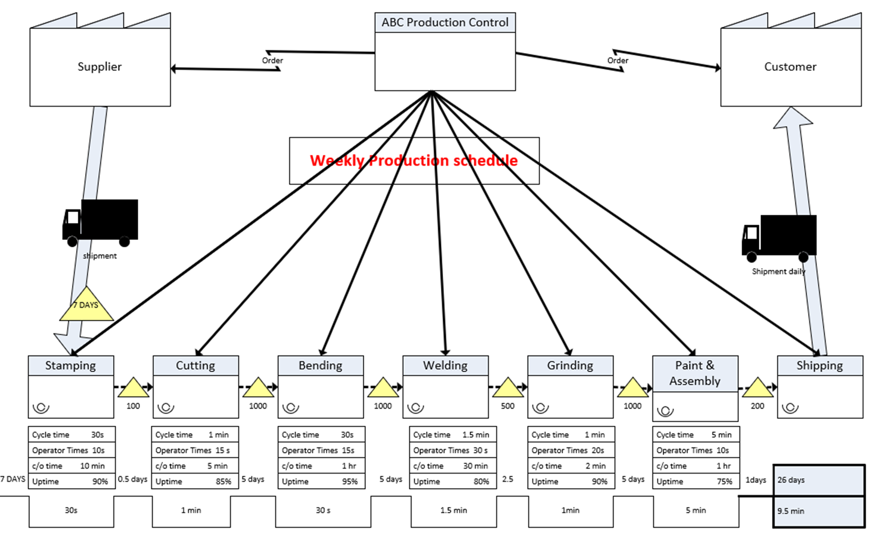
Value Stream Mapping
DMAIC

Slide 8
Measure
2
Identify the Cause to Improve
DMAIC

Slide 9
Process Capability
PROCESS CAPABILITY OF CURRENT STATE
USL | 0.100 | Month | Production | Defects | Defects/Production
LSL | 0.050 | January, 2018 | 5840 | 465 | 0.080
AVERAGE | 0.084 | February, 2018 | 3826 | 500 | 0.131
STANDARD DEVIATION | 0.031 | March,2018 | 3458 | 474 | 0.137
 |  | April,2018 | 3566 | 391 | 0.110
Cp | 0.269 | May,2018 | 4714 | 495 | 0.105
Cpl | 0.362 | June,2018 | 4499 | 329 | 0.073
Cpu | 0.175 | July,2018 | 6589 | 367 | 0.056
Cpk | min(0.362,0.175) | August,2018 | 5721 | 323 | 0.056
 | 0.175 | September,2018 | 5451 | 418 | 0.077
 |  | October,2018 | 7253 | 425 | 0.059
 |  | November,2018 | 4155 | 346 | 0.083
 |  | December,2018 | 7841 | 300 | 0.038
Process Not Capable
DMAIC

Slide 10
DPMO Current State
Month | Production | Defects
January | 5840 | 465
February | 3826 | 500
March | 3458 | 474
April | 3566 | 391
May | 4714 | 495
June | 4499 | 329
July | 6589 | 367
August | 5721 | 323
September | 5451 | 418
October | 7253 | 425
November | 4155 | 346
December | 7841 | 300
Total | 62913 | 4833
DPMO : 76820
Process Sigma : 2.9
DMAIC

Slide 11
Analyze
3
Identify the Cause of the Problem
DMAIC

Slide 12
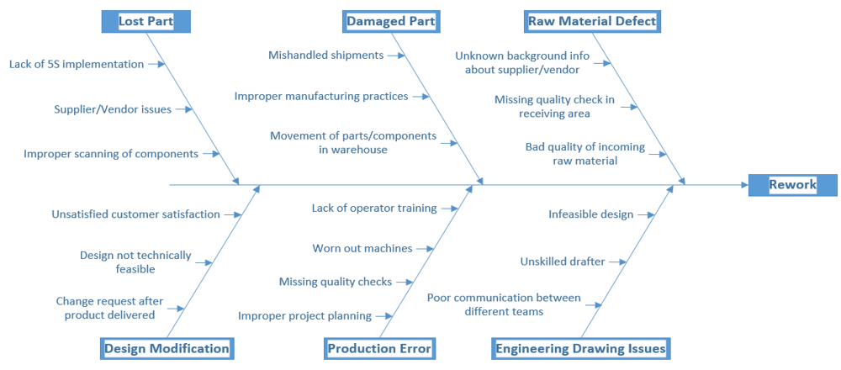
Cause and Effect
DMAIC

Slide 13
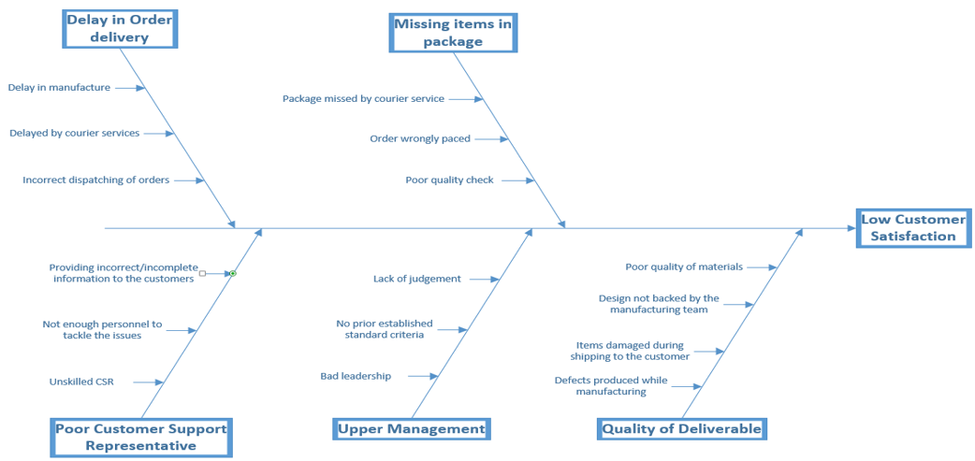
Cause and Effect
DMAIC

Slide 14
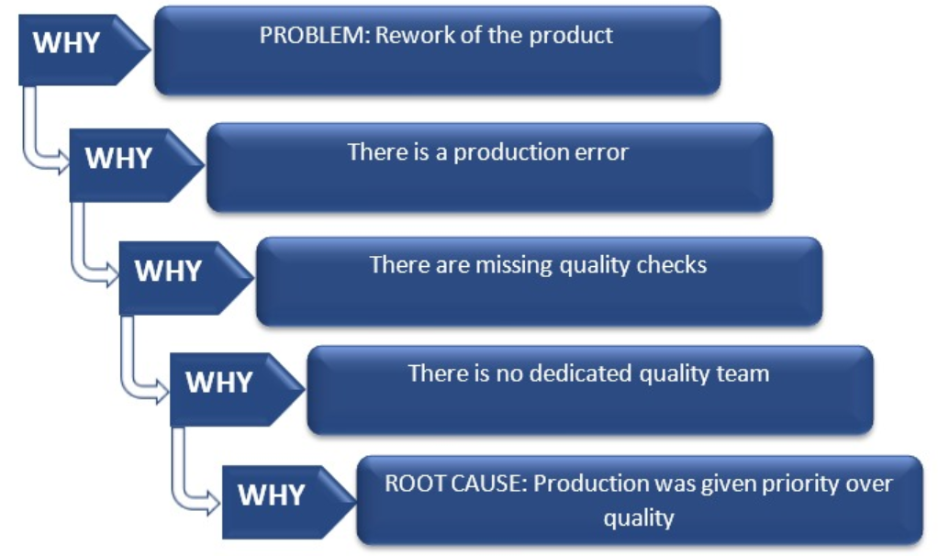
5-Why Techniques for Rework
DMAIC

Slide 15
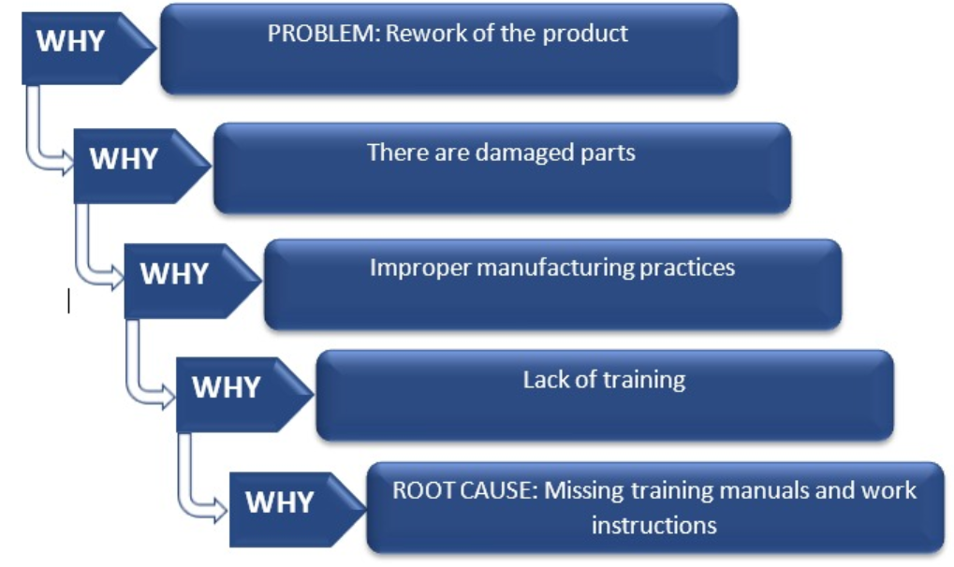
5-Why Techniques for Rework
DMAIC

Slide 16
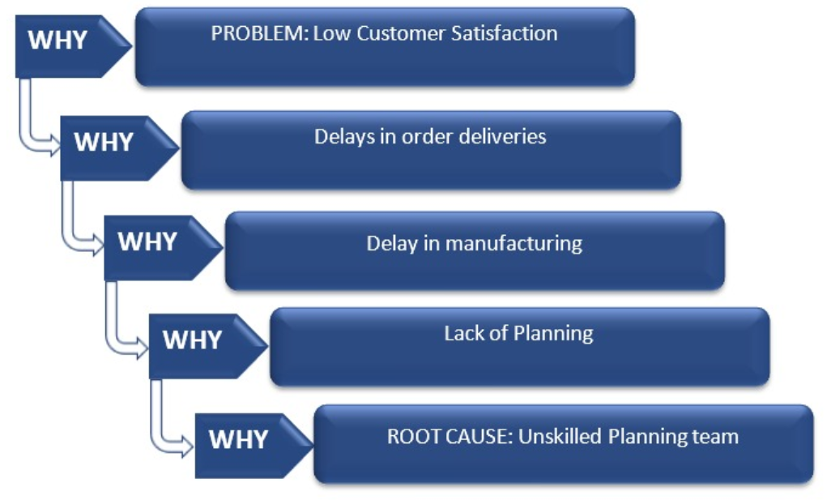
5-Why Techniques for Customer Satisfaction
DMAIC

Slide 17
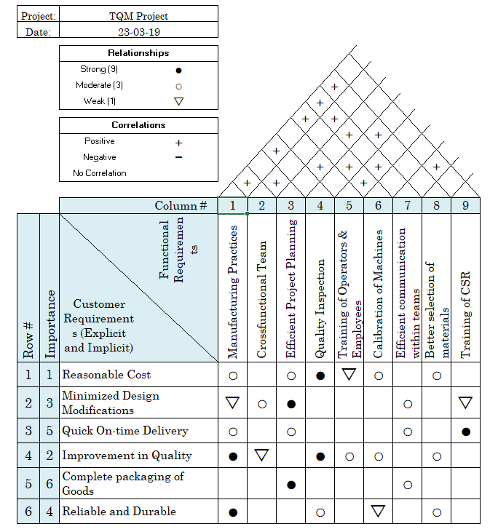
QFD
DMAIC

Slide 18
Improve
4
Implement and Verify the Solution
DMAIC

Slide 19

Brainstorming
Overall Customer Satisfaction
Re-work
Delays in order delivery
Missing items reported by users
Unskilled customer support
Lack of ownership in the management teams
Lost parts
Missing items
Lack of organized spaces
Lack of coordination
Improper project planning
Existing improper manufacturing practices
DMAIC

Slide 20
Kaizen Approach
Problems | Measures Taken
Production Errors/Defect | Introduce quality checks at every stage
Lack of proper manufacturing practices | Provide proper training to operators Checking the progress regularly Introduce trainings by experienced staff. Assign a Buddy Manager to a group of freshers.
Lack of coordination | Conduct regular meetings to track progress. Engaging teams in the Group-related activities. Efficient manager with effective communication and interpersonal skills.
Delay in Order delivery | Improve project planning. Achieve preventive maintenance
DMAIC

Slide 21
Poka Yoke Approach
Problems | Measures Taken
Production Errors | Provide checklist for all involved processes
Avoid accidents on the floor and resolve safety issues | Machines should go into idle state if the operator is away from the machine. Machines should be insulated and shock-proof. Machine should have warning signs to alert operators about safety issues
Insufficient technical knowledge of the Engineering team | Retrain the employees. Re-certify the skills of the employees. Document the processes by embedding the details in the process.
DMAIC

Slide 22
Control
5
Maintain the Solution
DMAIC

Slide 23
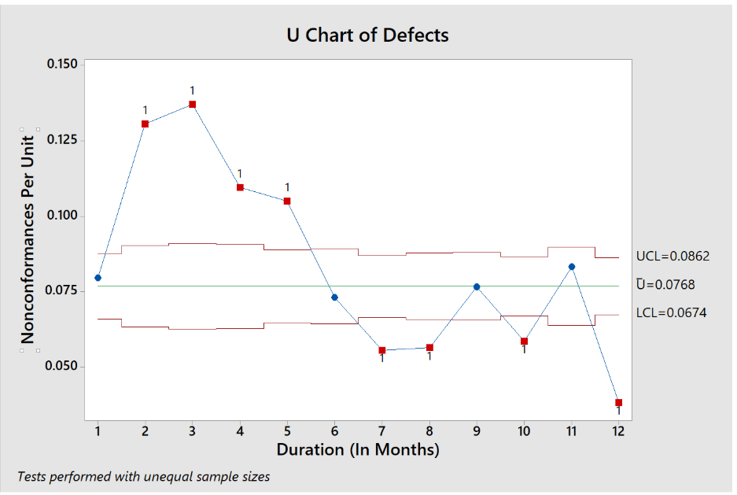
U-Chart Before Six Sigma
U-Chart of Defects
Control Limit Values : UCL = 0.0862 Ū=0.0768 LCL=0.0674
DMAIC

Slide 24
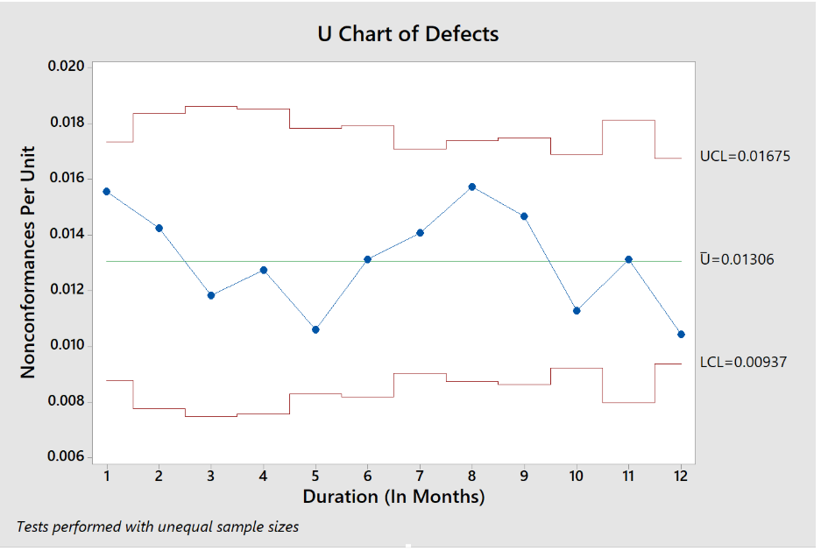
U-Chart After Six Sigma
U-Chart of Defects
Control Limit Values : UCL = 0.01675 Ū=0.01306 LCL=0.00937
DMAIC

Slide 25
Process Capability After Six Sigma
PROCESS CAPABILITY OF CURRENT STATE
USL | 0.020 | Month | Production | Defects | Defects/Production
LSL | 0.007 | January, 2018 | 6424 | 100 | 0.016
AVERAGE | 0.013 | February, 2018 | 4209 | 60 | 0.014
STANDARD DEVIATION | 0.002 | March,2018 | 3804 | 45 | 0.012
 |  | April,2018 | 3923 | 50 | 0.013
Cp | 1.195 | May,2018 | 5185 | 55 | 0.011
Cpl | 1.126 | June,2018 | 4949 | 65 | 0.013
Cpu | 1.265 | July,2018 | 7248 | 102 | 0.014
Cpk | min(1.126,1.265) | August,2018 | 6293 | 99 | 0.016
 | 1.126 | September,2018 | 5996 | 88 | 0.015
 |  | October,2018 | 7978 | 90 | 0.011
 |  | November,2018 | 4571 | 60 | 0.013
 |  | December,2018 | 8625 | 90 | 0.010
Process is Capable
DMAIC

Slide 26
DPMO Future State
Month | Production | Defects
January | 6424 | 100
February | 4209 | 60
March | 3804 | 45
April | 3923 | 50
May | 5185 | 55
June | 4949 | 65
July | 7248 | 102
August | 6293 | 99
September | 5996 | 88
October | 7978 | 90
November | 4571 | 60
December | 8625 | 90
Total | 69204 | 904
DPMO : 13063
Process Sigma : 3.7
DMAIC

Slide 27
Conclusion
DPMO is reduced from 76820 to 13063.
Process sigma is reduced from 3.9 to 2.7
Process is under control and stable. This is clearly visible in the control charts.
Process is consistent and capable as we have a Cp value of more than 1. This is clearly visible in the process capability calculations.
By implementing six sigma an amount of $ 419, 218 will be saved per year after the break even point(1.9 years).
DMAIC

Slide 28
“If you always do what you always did, you’ll always get what you’ve always got”. – Henry Ford
DMAIC

Slide 29
THANK YOU!
Any questions?
DMAIC

Slide 30
References
https://en.wikipedia.org/wiki/Six_Sigma
https://www.graphicproducts.com/articles/six-sigma-principles/
https://moodle.concordia.ca/moodle/course/view.php?id=113312
Class Notes & Text Book
DMAIC

